Slide 1
Virtual Bone Lab

Slide 2
Slide of Compact Bone
Canaliculi
(looks like “cracks” through the lamellae)
Lamellae is the hard matrix of bone

Slide 3
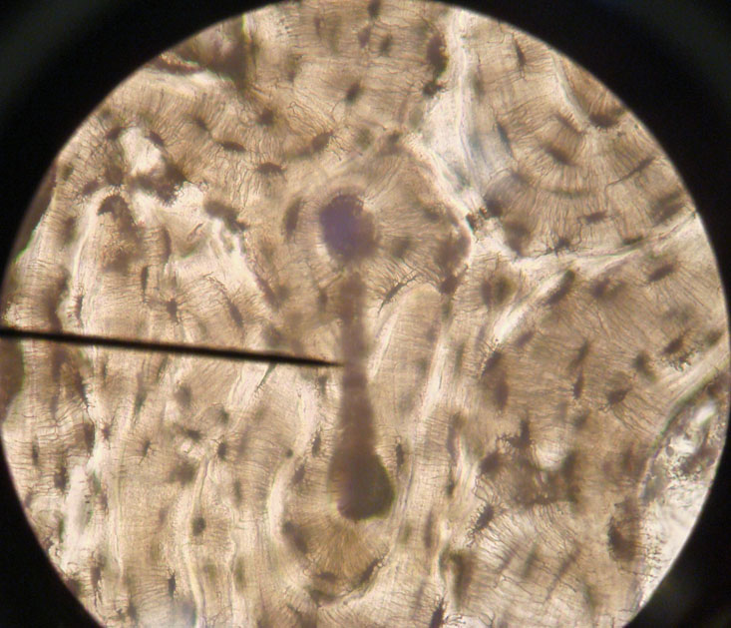
Slide of Compact Bone Pointer is on a Perforating (Volkmann’s Canal)

Slide 4
Bones of the Upper Limb
Humerus
Radius
Ulna
Carpals, Metacarpals, Phalanges

Slide 5
Humerus
Right Anterior
Humerus
Right Posterior
Humerus

Slide 6
Radius and Ulna

Slide 7
Carpals, Metacarpals, Phalanges

Slide 8
Bones of the Lower Limb
Femur
Tibia
Fibula
Tarsals, Metatarsals, Phalanges

Slide 9
Femur
Left Anterior
Femur
Right Posterior
Femur

Slide 10
Tibia & Fibula

Slide 11
Tibia Close-Up

Slide 12
Tarsals, Metatarsals & Phalanges

Slide 13
Vertebral Column
Cervical Vertebrae
Thoracic Vertebrae
Lumbar Vertebrae
Sacrum

Slide 14
Cervical Vertebra

Slide 15
Thoracic Vertebra

Slide 16
Lumbar Vertebra

Slide 17
Atlas

Slide 18
Axis

Slide 19
Atlas & Axis

Slide 20
Sacrum
Anterior Sacrum
Posterior Sacrum

Slide 21
Bones of the Thoracic Region
Scapula
Clavicle
Sternum
Ribs

Slide 22
Scapula - Anterior
Left Scapula
Right Scapula

Slide 23
Scapula - Posterior
Right Scapula
Left Scapula

Slide 24
Clavicle

Slide 25
Sternum

Slide 26
Ribs
Sorry – No picture available for ribs

Slide 27
The Pelvic Girdle
Ilium
Ischium
Pubis

Slide 28
Coxal Bones of the Pelvic Girdle
Right
Left

Slide 29
Coxal Bones of the Pelvic Girdle

Slide 30
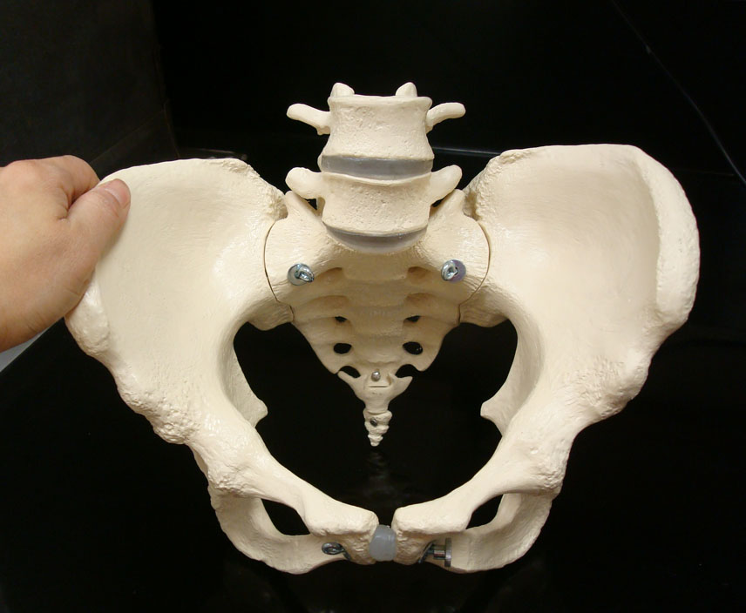
Female Pelvic Girdle
Wide pubic arch of the female pelvis
Wide pelvic brim of the female pelvis

Slide 31
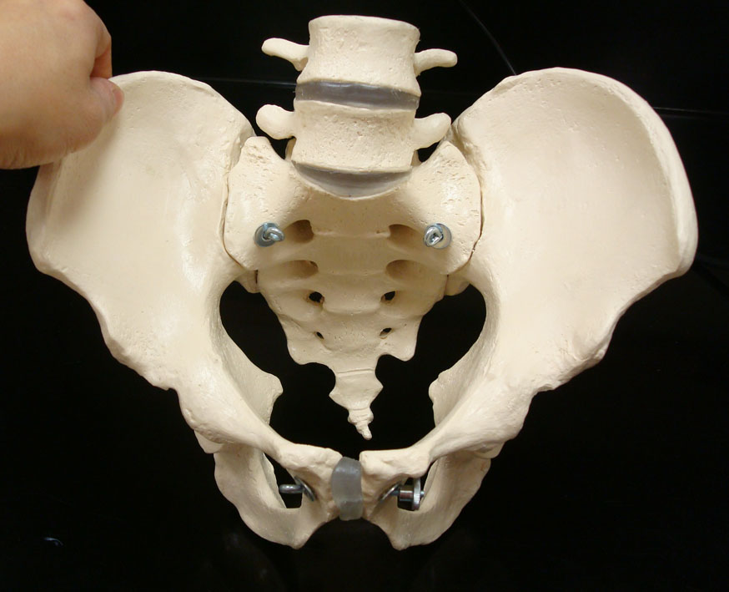
Male Pelvic Girdle
Narrow pubic arch of the male pelvis
Narrow pelvic brim of the male pelvis

